Slide 1

Behind the Box Office: Data-Driven Decisions in Filmmaking"
GROUP 1 PHASE 2 PROJECT

Slide 2
OVERVIEW OF THE PROJECT
The project focuses on analysing movie datasets to provide actionable insights for the creation of a new movie studio.
Using data visualization and analysis tools, such as Tableau and models
The project aims to identify trends and patterns in the movie industry, including top-performing genres, audience preferences and revenue-driving factors.

Slide 3
BUSINESS UNDERSTANDING
The company now sees all the big companies creating original video content and they want to get in on the fun. They have decided to create a new movie studio, but they don’t know anything about creating movies.
You are charged with exploring what types of films are currently doing the best at the box office. You must then translate those findings into actionable insights that the head of your company's new movie studio can use to help decide what type of films to create.

Slide 4
DATA UNDERSTANDING
Here will need to understand our data. This involves getting the relevant information from each dataset crucial for our analysis.
We start by loading the various datasets reviewing their various information based on the columns and check which information is necessary for our analysis before beginning the data cleaning.
Movie Performance Data
Box Office Data: Includes revenue by day, week, or year for individual movies. Useful for analysing trends in revenue over time.

Slide 5
DATA UNDERSTANDING Cont……1.
Weekend Box Office Data: Aggregated weekend earnings, helpful for identifying peaks in movie viewership.
Cumulative Box Office: Total earnings over time for each movie.
2. Movie Metadata
Movie Titles and Release Dates: Basic information about movies, such as title, genre, release date, and distributor.
Genre and Ratings: Helps in analyzing how genres or ratings affect performance
3. Home Entertainment Data
DVD/Blu-ray Sales: Useful for understanding post-theater revenue streams.
Digital Sales/Streaming Revenue: Can show trends in digital distribution.
4. Market-Level Data
Market Share by Studio: Helps analyze how different studios perform over time.
International Box Office: Useful for cross-region comparison and global trends.

Slide 6
DATA UNDERSTANDING Cont……1.
Weekend Box Office Data: Aggregated weekend earnings, helpful for identifying peaks in movie viewership.
Cumulative Box Office: Total earnings over time for each movie.
2. Movie Metadata
Movie Titles and Release Dates: Basic information about movies, such as title, genre, release date, and distributor.
Genre and Ratings: Helps in analyzing how genres or ratings affect performance

Slide 7
DATA UNDERSTANDING CONT…….2
3. Home Entertainment Data
DVD/Blu-ray Sales: Useful for understanding post-theatre revenue streams.
Digital Sales/Streaming Revenue: Can show trends in digital distribution.
4. Market-Level Data
Market Share by Studio: Helps analyse how different studios perform over time.
International Box Office: Useful for cross-region comparison and global trends.

Slide 8
OBJECTIVES/GOALS
Main Objective
- To analyse movie data and uncover key patterns in revenue, popularity, ratings, and director influence across genres, providing actionable insights for business growth and strategic decision-making.

Slide 9
OBJECTIVES (cont…2)
Specific Objectives
1. Identify the movie genres that generate the highest revenue and analyse the factors contributing to their financial success.
2. Explore audience preferences to uncover the most popular genres and the drivers behind their popularity.
3. Evaluate the ratings of movies across genres to assess trends in critical and audience reception.
4. Examine the role and impact of directors on the success of specific genres.
5. Identify top-performing movies within their respective genres.
6. Highlight the most successful and influential directors based on revenue and popularity.

Slide 10
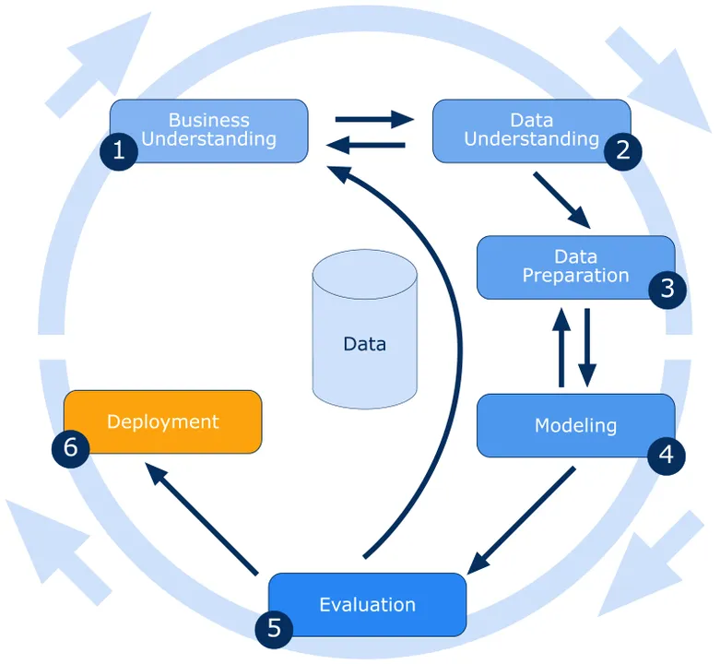
METHODOLOGY

Slide 11
DATA CLEANING REPORT
Modified columns names
Changed column data types
Removed duplicates
Removed outliers
Replaced/Drop null values
Feature engineering

Slide 12
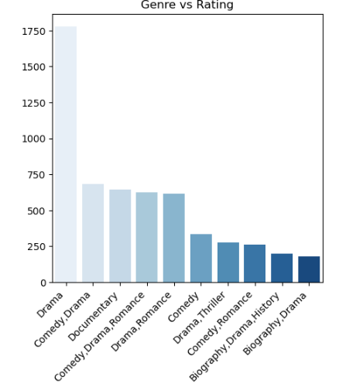
Comparison between genre and rating
The highly rated genre is drama.
Notes:
fig1:The highly rated genre is drama.

Slide 13
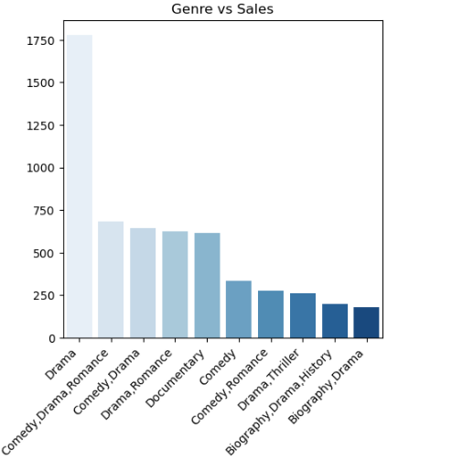
Comparison between genre and sales
Highest sales were from comedy, followed by drama.
Notes:
fig1:The highly rated genre is drama.

Slide 14
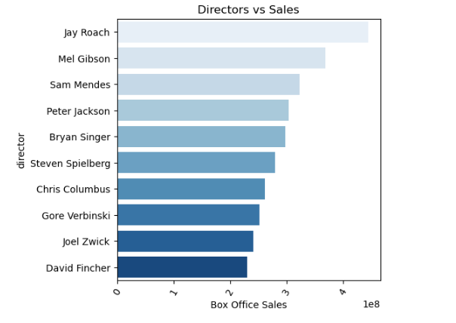
Comparison between directors and sales
Movies and films from Jay roach made highest sales followed by Mel Gibson and Sam Mendes.
Notes:
Fig 3:movies and films from Jay roach made highest sales followed by Mel Gibson and Sam Mendes.

Slide 15
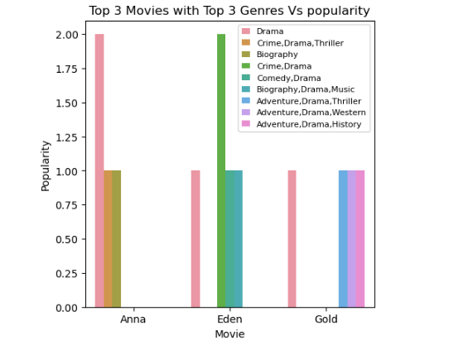
Top 3 movies with top 3 genres and popularity
Dramas from Anna were the most popular as well as crime, drama, thriller from Eden Movies.
Notes:
Fi 4:Dramas from Anna were the most popular as well as crim,drama,thriller from Eden Movies.

Slide 16
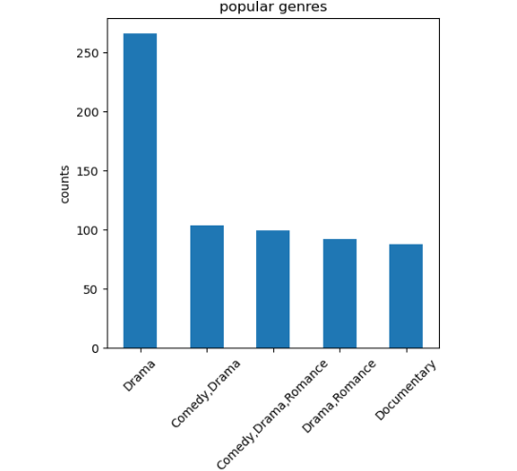
Top 5 popular genres
Drama was the most popular genre doubling the other categories.
Notes:
Fig 5:Drama was the most popular genre doubling the other categories.

Slide 17
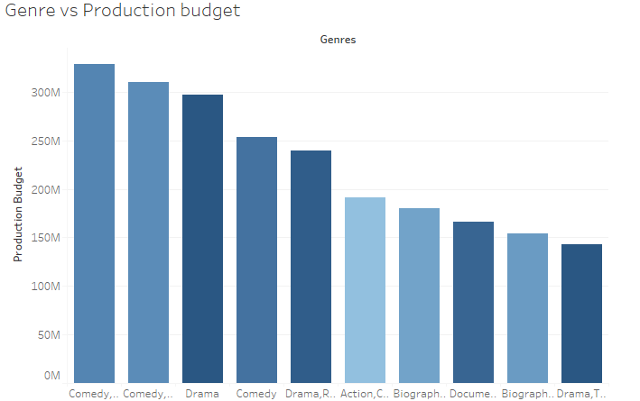
Comparison between genre and production budget
Comedy ,drama were costly in budget but gave the highest returns on investment.

Slide 18
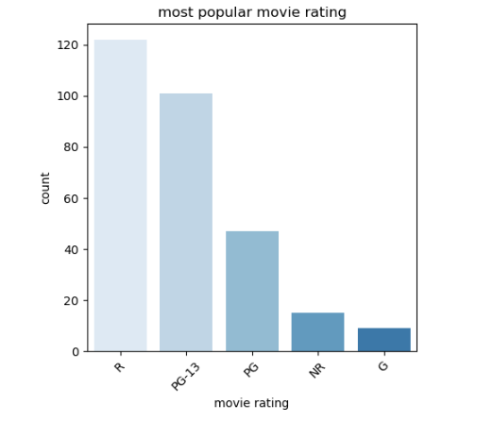
Top 5 most popular movie rating
R,PG-13,PG IN Descending order of popularity.
Notes:
Fig 7:R,PG-13,PG IN Descending order of popularity.

Slide 19
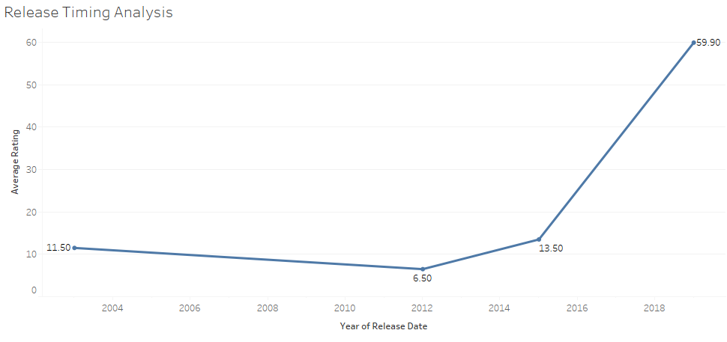
Yearly release timing analysis
Time series showed an upward trend in terms of Rating worth investing.

Slide 20
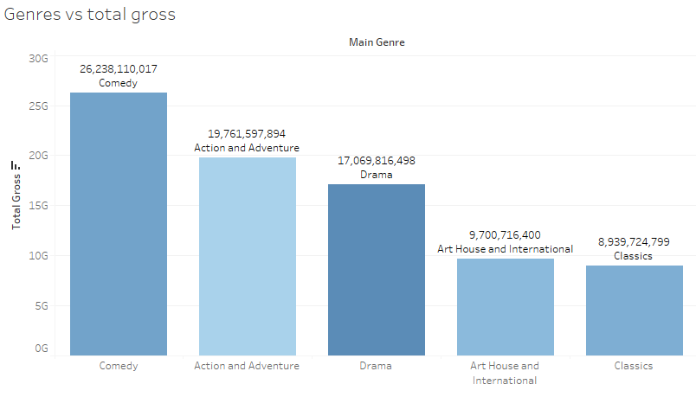
Comparison between genres and total gross
Drama, action and adventure, comedy showed an increasing trend in terms of gross profits.

Slide 21
RESULTS/FINDINGS
ROI Leaders: Action and Adventure genres lead in return on investment (ROI), making them highly profitable.
Budget Allocation: Production budgets are highest for Comedy and Drama, reflecting their revenue potential.
Studio Performance: Universal Pictures has the highest average ratings, showcasing its strong audience appeal.
Release Timing: Average ratings peaked in recent years, suggesting growing audience satisfaction with newer movies. ROI Leaders: Action and Adventure genres lead in return on investment (ROI), making them highly profitable.
Budget Allocation: Production budgets are highest for Comedy and Drama, reflecting their revenue potential.
Studio Performance: Universal Pictures has the highest average ratings, showcasing its strong audience appeal.
Release Timing: Average ratings peaked in recent years, suggesting growing audience satisfaction with newer movies.

Slide 22
RECOMMENDATIONS
Prioritize Action and Comedy genres for future productions, as they have proven to be the most lucrative and widely appreciated.
Partner with top-rated directors (e.g., Steven Spielberg, Clint Eastwood) and writers (e.g., Woody Allen) to enhance critical and audience reception.
Optimize movie runtimes based on audience preferences; longer runtimes for Action and Adventure, and shorter runtimes for genres like Animation.
Leverage Universal Pictures for distribution due to their strong track record in generating high ratings.

Slide 23
DATA PREPROCESSING REPORT
In this preprocessing step, the 'genres' column, which contains categorical data representing movie genres, is label-encoded using the LabelEncoder from scikit-learn.
Used label encoding to transform into each unique genre into a numerical value.
The encoded values are stored in a new column, genres_encoded, within the dataframe. This step helps prepare the dataset for modeling by converting the categorical target variable into a format suitable for algorithmic processing.

Slide 24
HYPOTHESIS TESTING REPORT
Testing the nature of the data.
Setting confidence interval.
Checking on the statistics of the average rating and total gross.
Stating the Null and alternative hypothesis.
Fail to reject the null hypothesis or not.

Slide 25
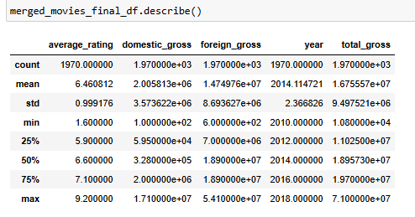
Testing the nature of the data

Slide 26
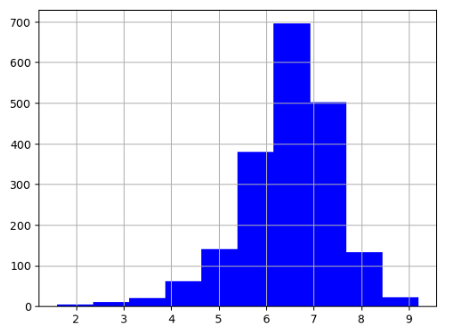
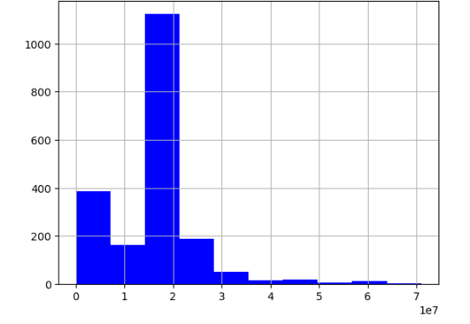
Statistics of the average rating and total gross.
Average rating
Total gross

Slide 27
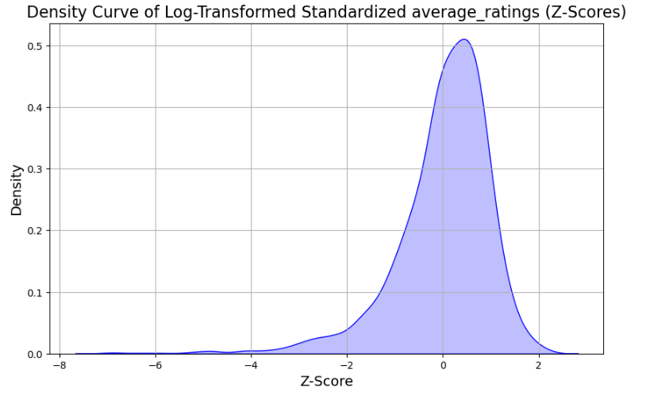
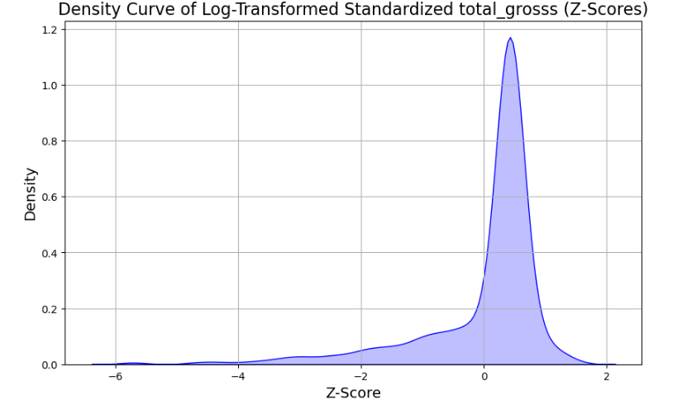
Statistics of the average rating and total gross after log transformation and standardization.
Average rating
Total gross

Slide 28
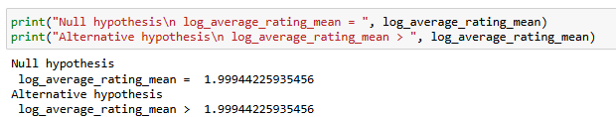
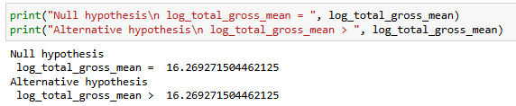
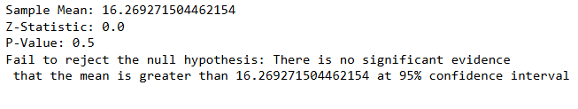

Null and alternative hypothesis.
Average rating
Total gross

Slide 29
MODELLING
Ordinary Least Squares (OLS) Regression
This is a linear regression model implemented using sm.OLS from the Statsmodels library. While OLS regression is generally used for continuous variables, it is applied here to the encoded categorical variable 'genres_encoded' to examine the relationship between the independent variables ('total_gross', 'average_rating', etc.) and the dependent variable. The result.summary() function generates a comprehensive statistical summary of the OLS regression, which includes key metrics such as coefficients, p-values, R-squared, and other diagnostic statistics to evaluate model performance.
Logistic Regression Model
Logistic Regression is used for predicting categorical outcomes, making it suitable for multi-class classification. In this case, the model is trained on the features 'total_gross' and 'average_rating' to predict the encoded 'genres' variable.
The data is split into training and testing sets (80% for training and 20% for testing), and the logistic regression model is fitted to the training data using model.fit(). This approach is typical for classification tasks where the goal is to estimate the probability of each class.

Slide 30
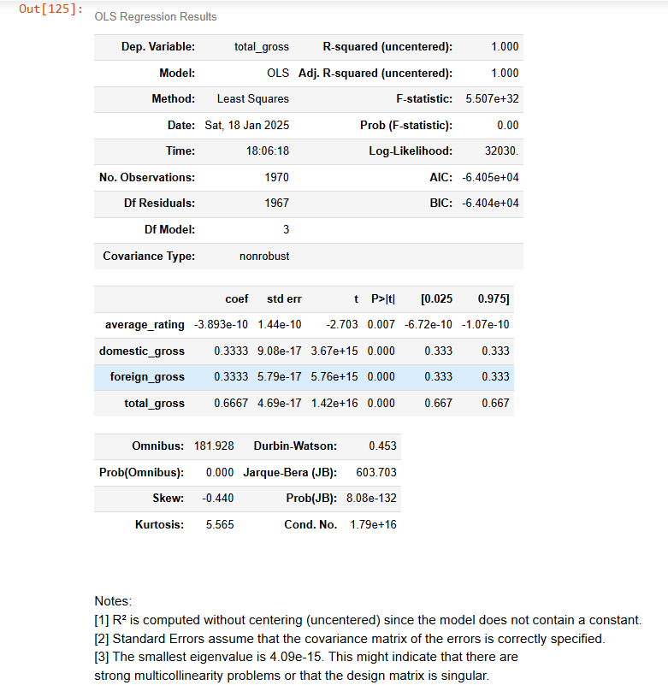
MODELING REPORT
Ordinary Least Squares (OLS) Regression

Slide 31
MODELING REPORT
Logistic Regression Model
The logistic regression model's performance is suboptimal, as reflected by the following key observations:
High Errors: The MAE (65.66), MSE (8101.98), and RMSE (90.01) indicate significant prediction errors on average.
Negative R² (-0.378): The negative R² suggests the model performs worse than simply predicting the mean of the target variable.
Model Improvements Needed: The model likely requires better feature engineering, data preprocessing, and possibly a different model approach to improve accuracy and fit.

Slide 32
CONCLUSION
From the analysis, it is clear that the Drama genre enjoys the highest ratings, but its box office success fluctuates over time. While the Adventure, Comedy, and Sci-Fi genres remain the highest-selling genres, this is likely due to their broad appeal and entertainment value.
Directors like Clint Eastwood(with strong reputations) and Jay Roach(on sales) contribute significantly to the sales, with their strong reputations and professional standards. The ratings analysis also highlights the R rating's popularity, reflecting the tastes of adult audiences.
Overall, the variability in movie sales and ratings over the years is likely driven by factors such as market dynamics, audience preferences, and the quality of direction and production.

Slide 33
ACKNOWLEDGEMENT
We would like to acknowledge all the group one members for working tirelessly to contribute to this project:
We would also like to pass our regard tour technical mentor MR.William Okomba having shaped our journey of learning data science.
All our colleagues who have been helping us to debug whenever in need.

Slide 34
The Future?
We are certain that these insights would go along way to have an impact on the business ;In future think of partnering with me for further insightful analysis for impactful data driven strategies bridging the gap between numbers and meaningful decisions.

Slide 35
CONTACT INFORMATION
catherine.kiptui@student.moringaschool.com
michellekavetza@gmail.com
gateromichael@gmail.com
noordinoordino470@gmail.com
kennethnyangweso99@gmail.com
aumakrystel5@gmail.com
segomich227@gmail.com

Slide 36
Questions?

